Slide 1
Gifted and Talented Education Program
Board of Education Presentation
September 6, 2016

Slide 2
How to Spot a Gifted Student
Gifted students possess some common characteristics. Recognizing these general traits and understanding how they may reveal themselves in the classroom is an important step toward working effectively with this unique group of children.
Some of these behaviors are listed and described on the slides that follow. Positive traits are included along with those behaviors that may frustrate you as a teacher. If a student in your classroom exhibits these characteristics on a consistent basis, there is a good chance he or she is gifted.

Slide 3
The Gifted Student | But…
Asks many questions and is very curious Possesses a large amount of information Has a good memory | Easily gets “off task” and “off topic” Is impatient when not called on in class
Learns new information quickly Retains information easily Masters reading skills earlier Demonstrates strong abilities in Math Displays unusual academic achievement Finishes classwork quickly | Is easily bored Can become disruptive in class Shows strong resistance to repetitive activities and memorization Completes work quickly but sloppily
Is interested in many things Becomes involved in a variety of activities Is motivated to try new things Enjoys a challenge | May resist working on activities apart from areas of interest Leaves projects unfinished Takes on too much and becomes overwhelmed
Thinks independently Expresses unique and original opinions Is self-motivated | Challenges authority Does not handle criticism well Does not work well in groups
Uses higher level thinking skills (analysis, synthesis, evaluation) Makes Connections other students don’t see Considers unusual approaches to problem-solving | Tends to be absent-minded regarding practical details Forgets homework assignments
Has a strong sense of justice Likes to debate current issues and real life problems | Can be very critical of self and others Likes to argue a point Is a perfectionist and expects others to be as well
Has a sophisticate sense of humor Understands subtle humor Enjoys plays on words and satire | Easily gets carried away with a joke Has a tendency to become the “class clown”
Demonstrates strong expressive skills Is sensitive to feelings of others Elaborates on ideas Shows skill in dram/art/music/language | Sometimes perceived as a “know –it-all” by peers Is sometimes “bossy” to peers in group situations

Slide 5
Dr. Harry Passow’s “Could, Should, Would” Test
Would all your students want to be involved?
Could all your students participate in this work?
Should all students be expected to participate?
If the answer is YES, then the work is not truly differentiated, or, in this case accelerated appropriately for the specific group of students who need that experience.

Slide 6
Philosophy of Gifted Education
Giftedness occurs in many different disciplines, in many different cultures, and in all socioeconomic levels. Identification should be based on multiple measures of success, including achievement and aptitude tests, teacher referrals and observations, parent referrals, and portfolio submissions. Students identified as gifted, no matter what area of giftedness, deserve to be challenged and helped to reach their full potential. Gifted students should be offered the chance to expand their knowledge base and develop their special talents. Differentiation for gifted learners should occur in the classroom, including offering different content, process, and products for these learners. Gifted students’ social and emotional needs should also be addressed as they may develop in different ways than their peers.

Slide 7
Avondale Schools Gifted and Talented Program Tentative Plan

Slide 8
2017-2018 3rd and 4th Grade Multi-Aged Classroom(s) at Woodland Elementary

Slide 9
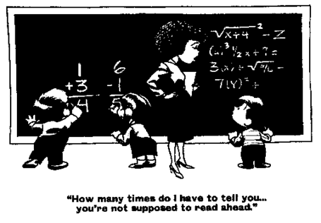
2018-2019 Potential opening of Multi-Aged Classroom(s) in Grades 2-3, 3-4, and 4-5

Slide 10
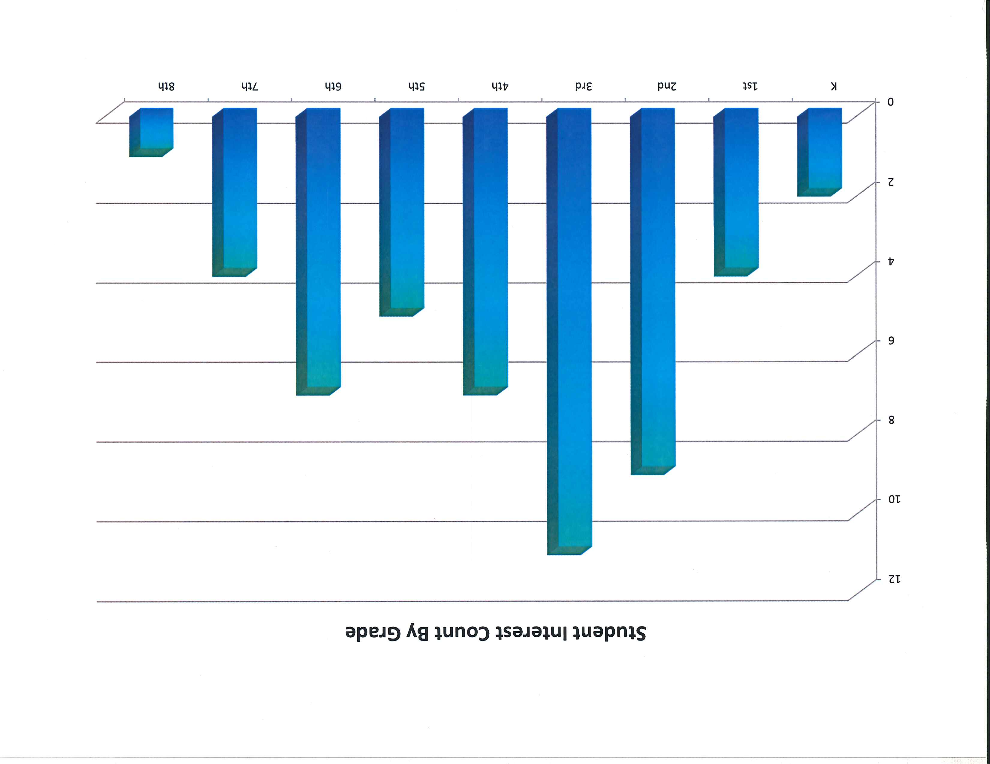

Slide 11
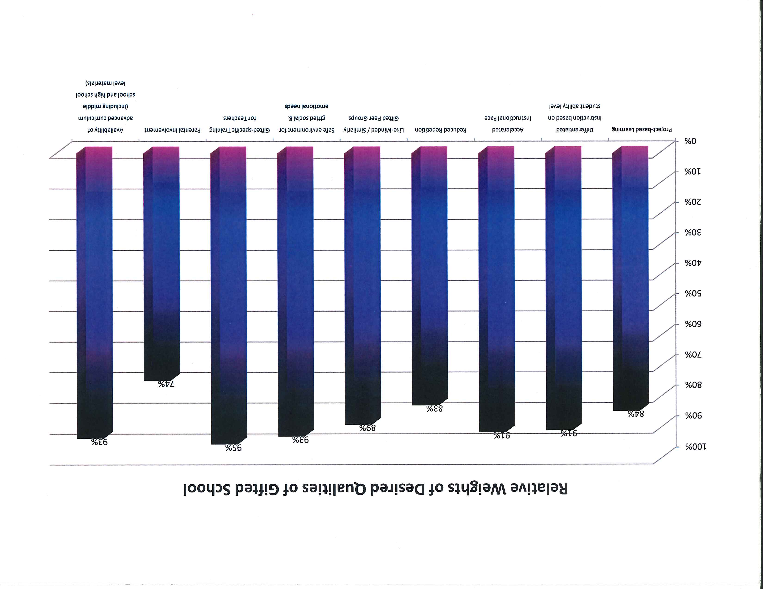

Slide 12
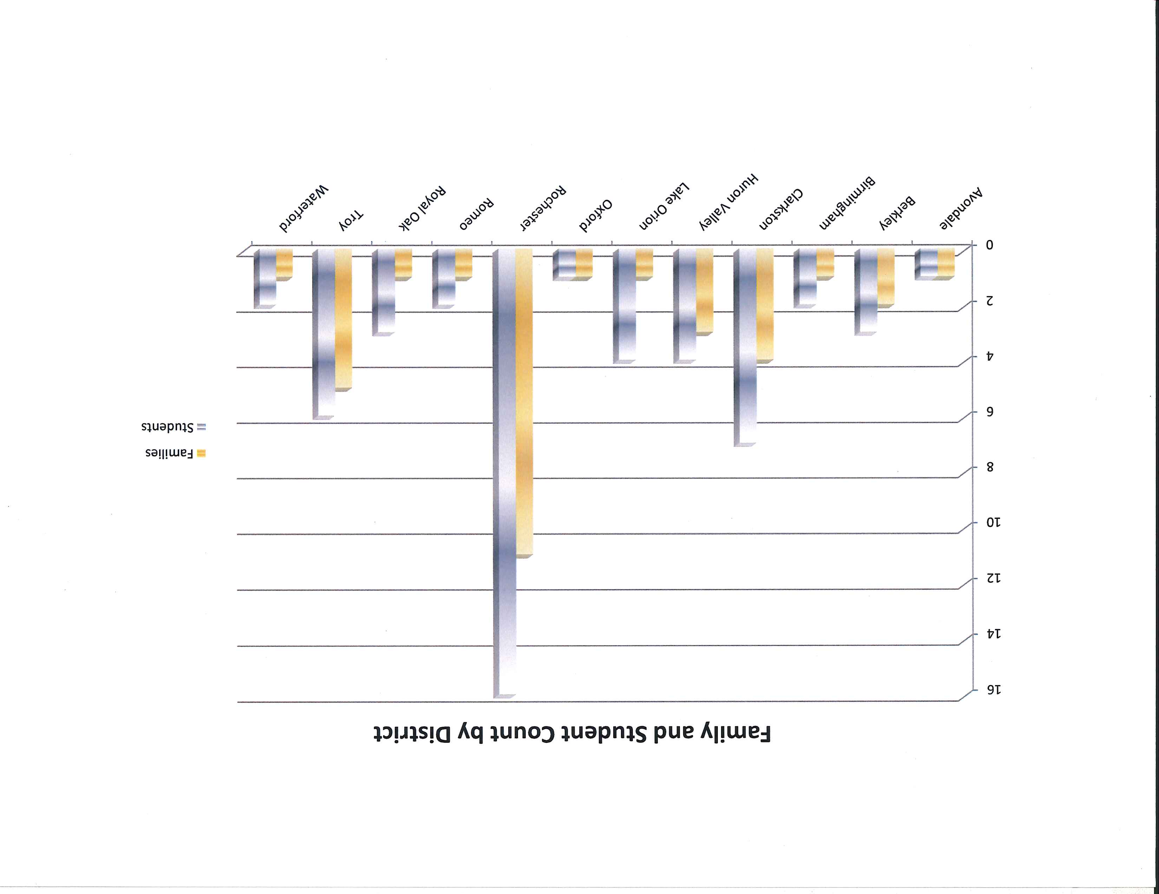

Slide 15
Avondale Magnet Program for the Gifted

Slide 16
Proposed Timeline

Slide 17
August & September
August 18 | Share Information with Administrative Staff regarding GT – invite Ann
August 25 | Meeting with Parent Group – Gifted Education in Eastern Oakland County parent network
September 1 | Job Descriptions, Roles and Expectations completed for Teacher, Coordinator and TC
September 6 | Board Presentation
September 19 | Board Meeting Approval
September 26 | Volunteer Staff Meetings in Elementary Buildings – GT Information Have ready for distribution – Nomination Packet

Slide 18
October & November
October 3rd | Send Parent Meeting Invites
October 15th | Gifted and Talented Conference
October 18th | Parent Meeting at Woodland (Distribute Nomination Packet)
October 19th | Parent Meeting at Auburn (Distribute Nomination Packet)
October 24th | Post Teacher Position (Goal: Determine by Thanksgiving Break – Nov. 23)
October 27th | Parent Teacher Conferences
November 3rd | Parent Teacher Conferences
November 18th | Parent and Teacher Nomination Packets Due
*Month of October: Review District-wide child study process (S3, TAT)

Slide 19
December
December 2nd | Teacher Nomination and Indication Surveys Due
December 6th | Selection Committee
December 7th | Selection Committee
December 8th | Send Letters to Parents
December 7th– December 21st | Parents Communicate Acceptance
December 14th | Deadline Parents Submit Appeals
December 19th | Appeal Committee Meets
December 20th | Appeal Committee Meets

Slide 20
January & February
January 4th | Number of School of Choice Open Seats Available to Jim
January 9th | School Board Meeting – Presentation of School of Choice
January 23rd | School Board Meeting – School of Choice Seats Approval
February | GT Advertisement – Application and Nomination Packets Ready

Slide 21
April , May & June
April 10th – May 10th | School of Choice Window- GT Application and Avondale Application Due
April 17th – May 12th | School of Choice Standardized Testing
May 20th | Saturday School of Choice Standardize Testing
May 23rd , May 24th | School of Choice Selection Committee
May 26th | Send letters to School of Choice Parents
June 9th | Parents communicate acceptance
June 22nd | Deadline School of Choice Parents Submit Appeal based on eligibility
June 23rd , June 24th | Appeal Committee Meets regarding eligibility of denied students

Slide 22
Student Identification Components:
iReady Data – Math and Reading
Fountas and Pinnell – Reading Data
Parent: Nomination Form, Parent Evaluation of Academic Talent Traits
Teacher: Nomination Form and/or Language Arts Talent Indication, Math Talent Indication, Gifted and Talented, Additional Information
Student Evidence of Creativity

Slide 23
Selection Committee
Teacher from Auburn
Teacher from Deerfield
Teacher from Graham
Teacher from Woodland
Ann Passino (Consultant)
Hillary Olance
Katherine Nash (TC)
Amanda Barber (TC)
Carmen Kennedy

Slide 24
Appeal Committee
Erik Makie (Psychologist)
Marty Alwardt
Arryn Schneider
Dr. James Schwarz
Ann Passino (Consultant)

Slide 25
Questions?

